Slide 1
Capstone Project
The Battle of The Neighborhood Presentation
Rose Condon
October 22, 2019

Slide 2


Content
1
Project Introductions
2
Data Descriptions
3
Methodology
4
Tools and Process
5
Conclusion and Improvement

Slide 3
Project Introduction
This project is the final assignment for Applied Data Science Capstone course on Coursera.
The purpose of this project is to discuss a business problem; leverage what the data science certificate courses cover and discover the solution.
This is a good exercise for the learners to explore data to find out the opportunity in business use case study.
The business problem address here is about recent EQAO results for 2017-2018 in Toronto Jr elementary schools and Sr secondary schools.
The EQAO results rise public immediate attentions regarding the academic improvement.
Background
Problem

Slide 4
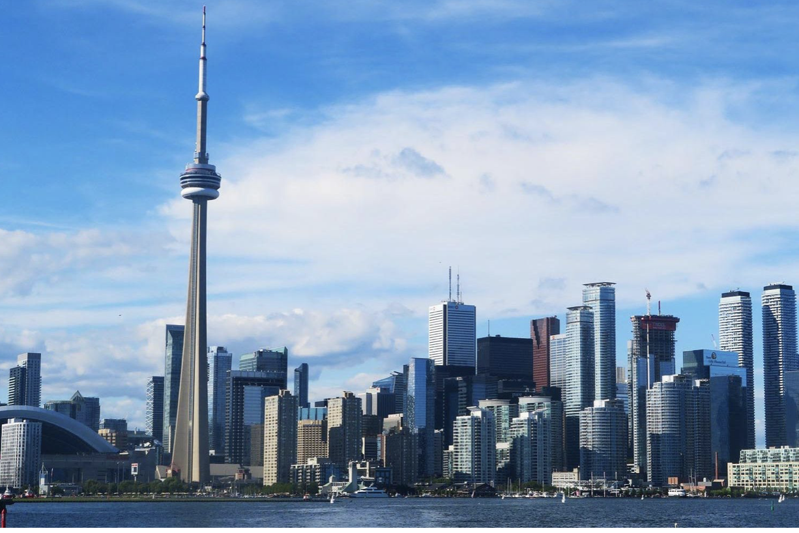
Toronto – International Business Center
About Toronto
Toronto is the biggest city in Canada, with a population of 2,731,571.
Toronto is a truly international business center in North America and financial capital of Canada
Toronto is also the largest centre of education, research and innovation in Canada
All schools in Toronto take their curricular mandate from the Ontario Ministry of Education
There are four types of school boards in Ontario, English Public, English Catholic, French Public, or French Catholic schools.

Slide 5
1
EQAO is an an independent government agency in Ontario. EQAO is develops and oversees tests that Ontario students must take in Grades 3, 6, 9, and 10.
2
According to EQAO results, 62%of Grade 3 students met the math standards and For Grade 9 students, only 44 per cent met the standard in the applied math
Problems and the Impacts
3
The Ontario Government announced a four-year math strategy after the release of results from 2017-2018 year’s EQAO standardized testing.
4
There is growing number of students using or searching for private tutor services.

Slide 6
Business Opportunity
Business problem brings opportunities. Want to open a after-school tutor service in Toronto?
“Sounds a good idea. Are there any data analysis need to be done before put idea into an action?”
“I have been googling for this kind of opportunity, but I am not familiar the software can help me to make up my mind, any suggestions …”
“Where is the ideal location ?”

Slide 7
Content
1
Project Introductions
2
Data Descriptions
3
Methodology
4
Tools and Process
5
Conclusion and Improvement

Slide 8

Data Descriptions
Data preparation in most cases require up to 80% time in the Data Science project. How data is gathered and analyzed depends on many factors.
Aspects should be considered in the data collection
Toronto nationhood Data : collected from WiKI
Toronto schools Data : collected from Toronto city open dataset
Geo data : collected from Wiki and others
School Ranking data : collected Fraser Institute web site
Correlation data : existing tutor services; and borough income range

Slide 9
Content
1
Project Introductions
2
Data Descriptions
3
Methodology
4
Tools and Process
5
Conclusion and Improvement

Slide 10
Methodology in Data Science Project
According to one of the course in Professional Data Science Certificate, the methodology in Data Science contains 5 main aspects.
1. From Problem to Approach
2. From Requirements to Collection
3. From Understanding to Preparation
4. From Modelling to Evaluation
5. From Deployment to Feedback

Slide 11
Five Aspects in Methodology
Problem to Approach
What problem trying to resolve
Can we get the data
How to use data
Feedback and Improvement
Discover problem
Deployment to Feedback
Requirement to Collection
Can model identify high-risk patients
Can we use model design suitable intervention actions
Have received constructive feedbacks
What data do I need.
Where is data source.
How to get the data.
Apply Analytic approch
Methodology
Building on understanding
Preparing Data
Modelling to Evaluation
Understanding to Preparation
What training set for predictive modelling
Which algorithms will be used
Which way to visualize data
Has seeking clarification been done
Is collected data representative
Which analytic approaches will be applied.

Slide 12
Content
1
Project Introductions
2
Data Descriptions
3
Methodology
4
Tools and Process
5
Conclusion and Improvement

Slide 13
Tools and Process
This is project uses the Jupyter Notebook for development IDE using Python programming as well as data science libraries, ie, pandas, matplotlib, seaborn, etc
The Data sources are collected from data providers on public data repositories
Identifying the necessary data contents, format from initial data collection
Leverage Foursquare API to access location data
Conduct statistical analysis and descriptive model
Apply linear regression machine learning algorithm
Using visualization libraries for better insights about the data

Slide 14
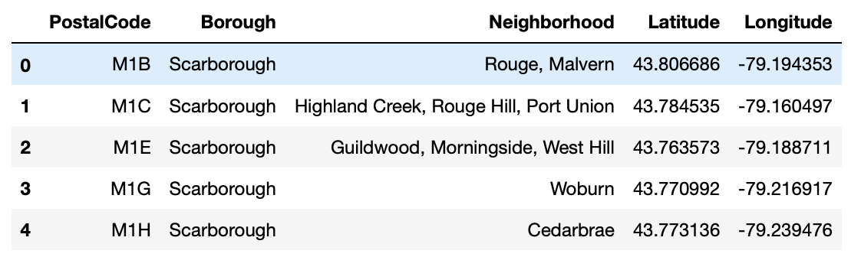
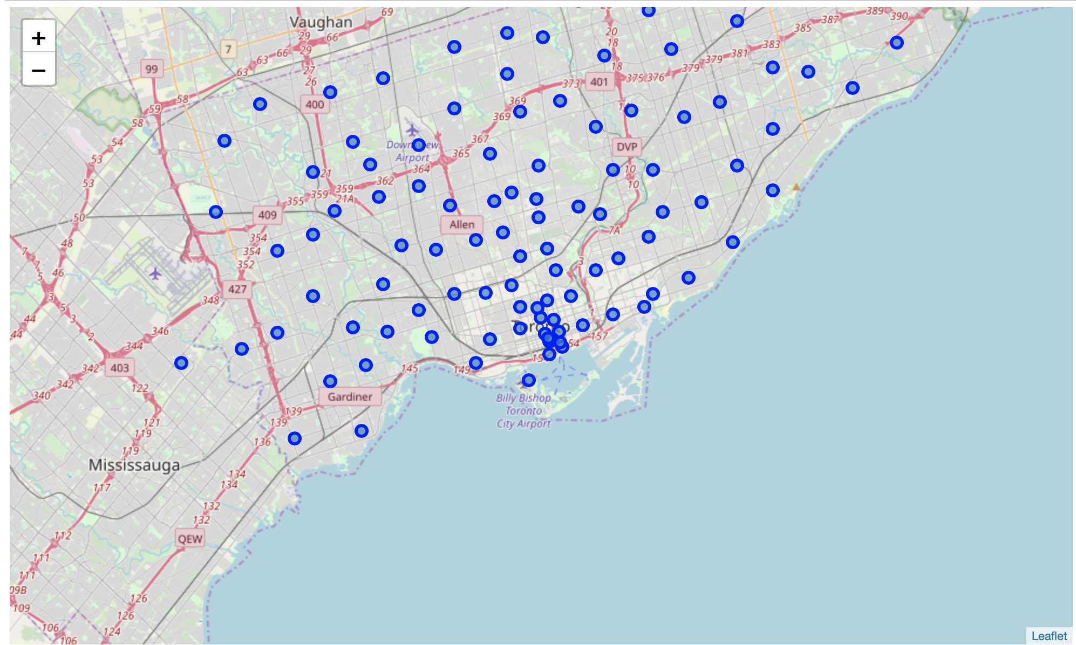
Toronto neighborhood Data: including borough, geo location and address

Slide 15
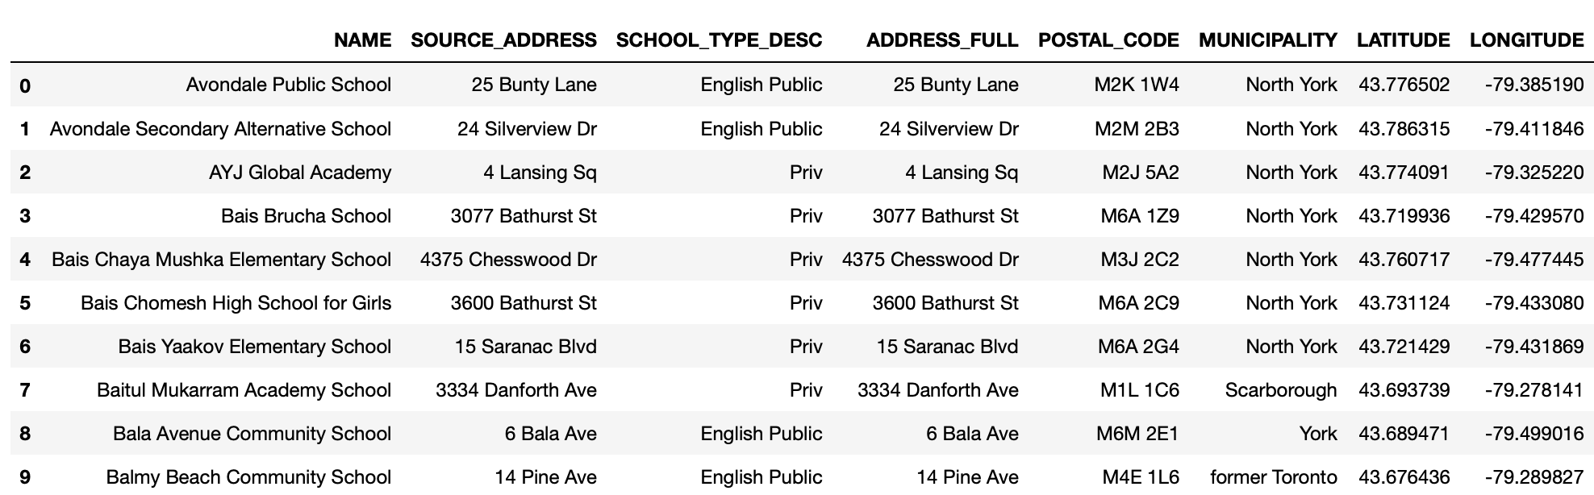
After done some data clean up, here we have nice Toronto Schools Data which is including name, geo location and address

Slide 16
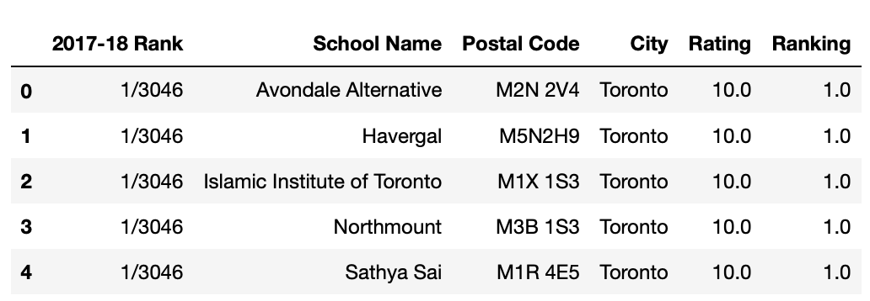
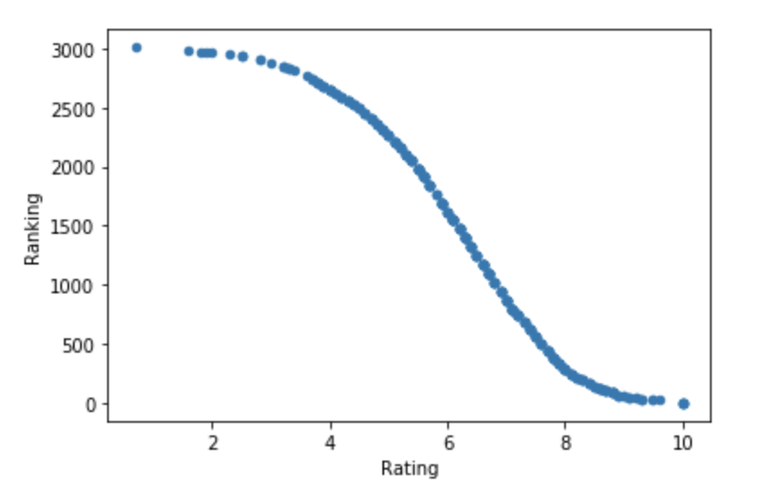
Data clean up and re-order need to be done for Toronto Schools Ranking Data for Junior Elementary Schools
Use matplotlib for better insights of the average ranking

Slide 17
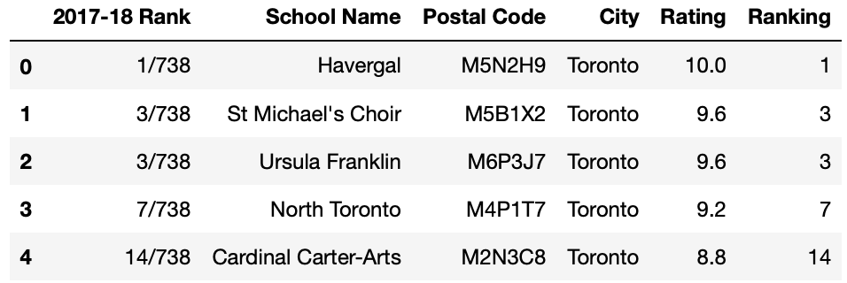
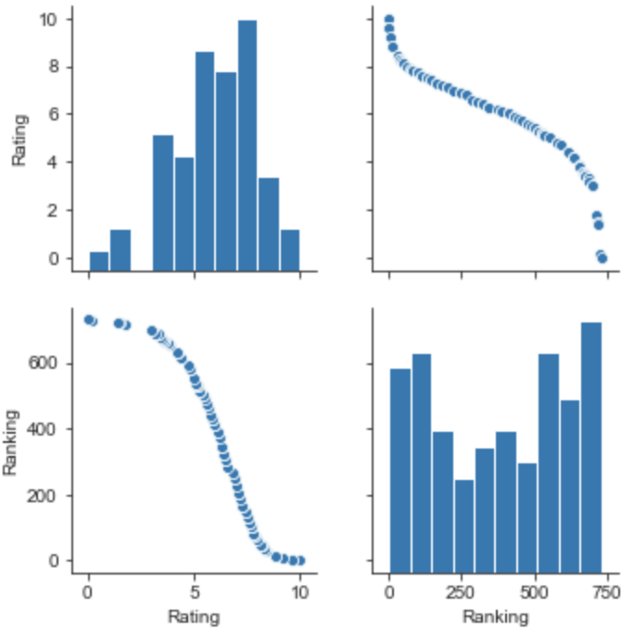
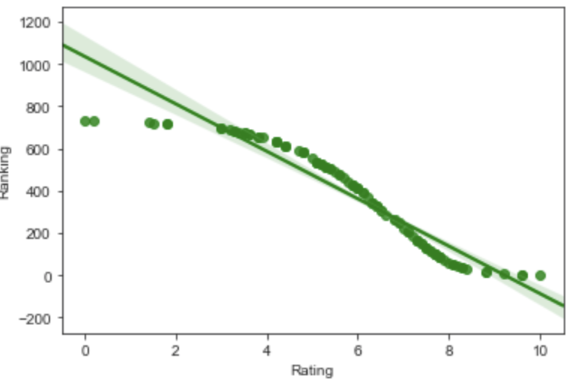
Same activates of Data clean up and re-order for Toronto Schools Ranking Data for Senior Secondary Schools
Use matplotlib and seaborn to create plots for better insights of the average ranking

Slide 18
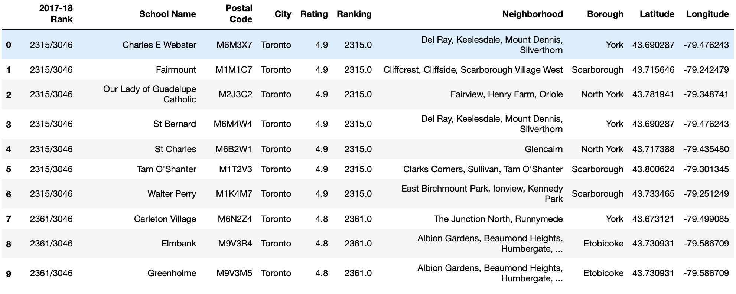
We have our target schools. Now we need to find out the correlation data
- the neighborhood geo data for the conclusion

Slide 19
Content
1
Project Introductions
2
Data Descriptions
3
Methodology
4
Tools and Process
5
Conclusion and Improvement

Slide 20
Conclusions
Now we can come out a list of name to answer the business problem question:
- Which areas or neighborhoods in Toronto are ideal locations to open a after-school tutor service?
Del Ray, Keelesdale, Mount Dennis, Silverthorn,
Cliffcrest, Cliffside, Scarborough Village West,
Glencairn,
East Birchmount Park, Ionview, Kennedy Park,
Albion Gardens, Beaumond Heights, Humbergate, Jamestown, Mount Olive, Silverstone, South Steeles, Thistletown, Downsview, North Park, Upwood Park,
Emery, Humberlea,
Rouge, Malvern,
East Toronto,
Church and Wellesley,
Christie,
Caledonia-Fairbanks,
Downsview Northwest,
Dovercourt Village, Dufferin,
Dorset Park, Scarborough Town Centre, Wexford Heights,
Parkwoods,
Kingsview Village, Martin Grove Gardens, Richview Gardens, St. Phillips,
Harbord, University of Toronto,
Runnymede, Swansea,
Guildwood, Morningside, West Hill, Woburn,
Maryvale, Wexford,
Agincourt, Northwest,
"LAmoreaux West",
Brockton, Exhibition Place, Parkdale Village,
Newtonbrook, Willowdale

Slide 21
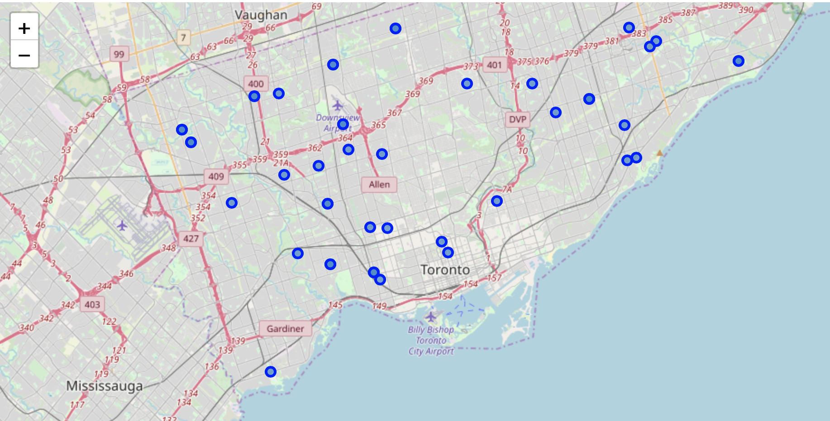

Slide 22
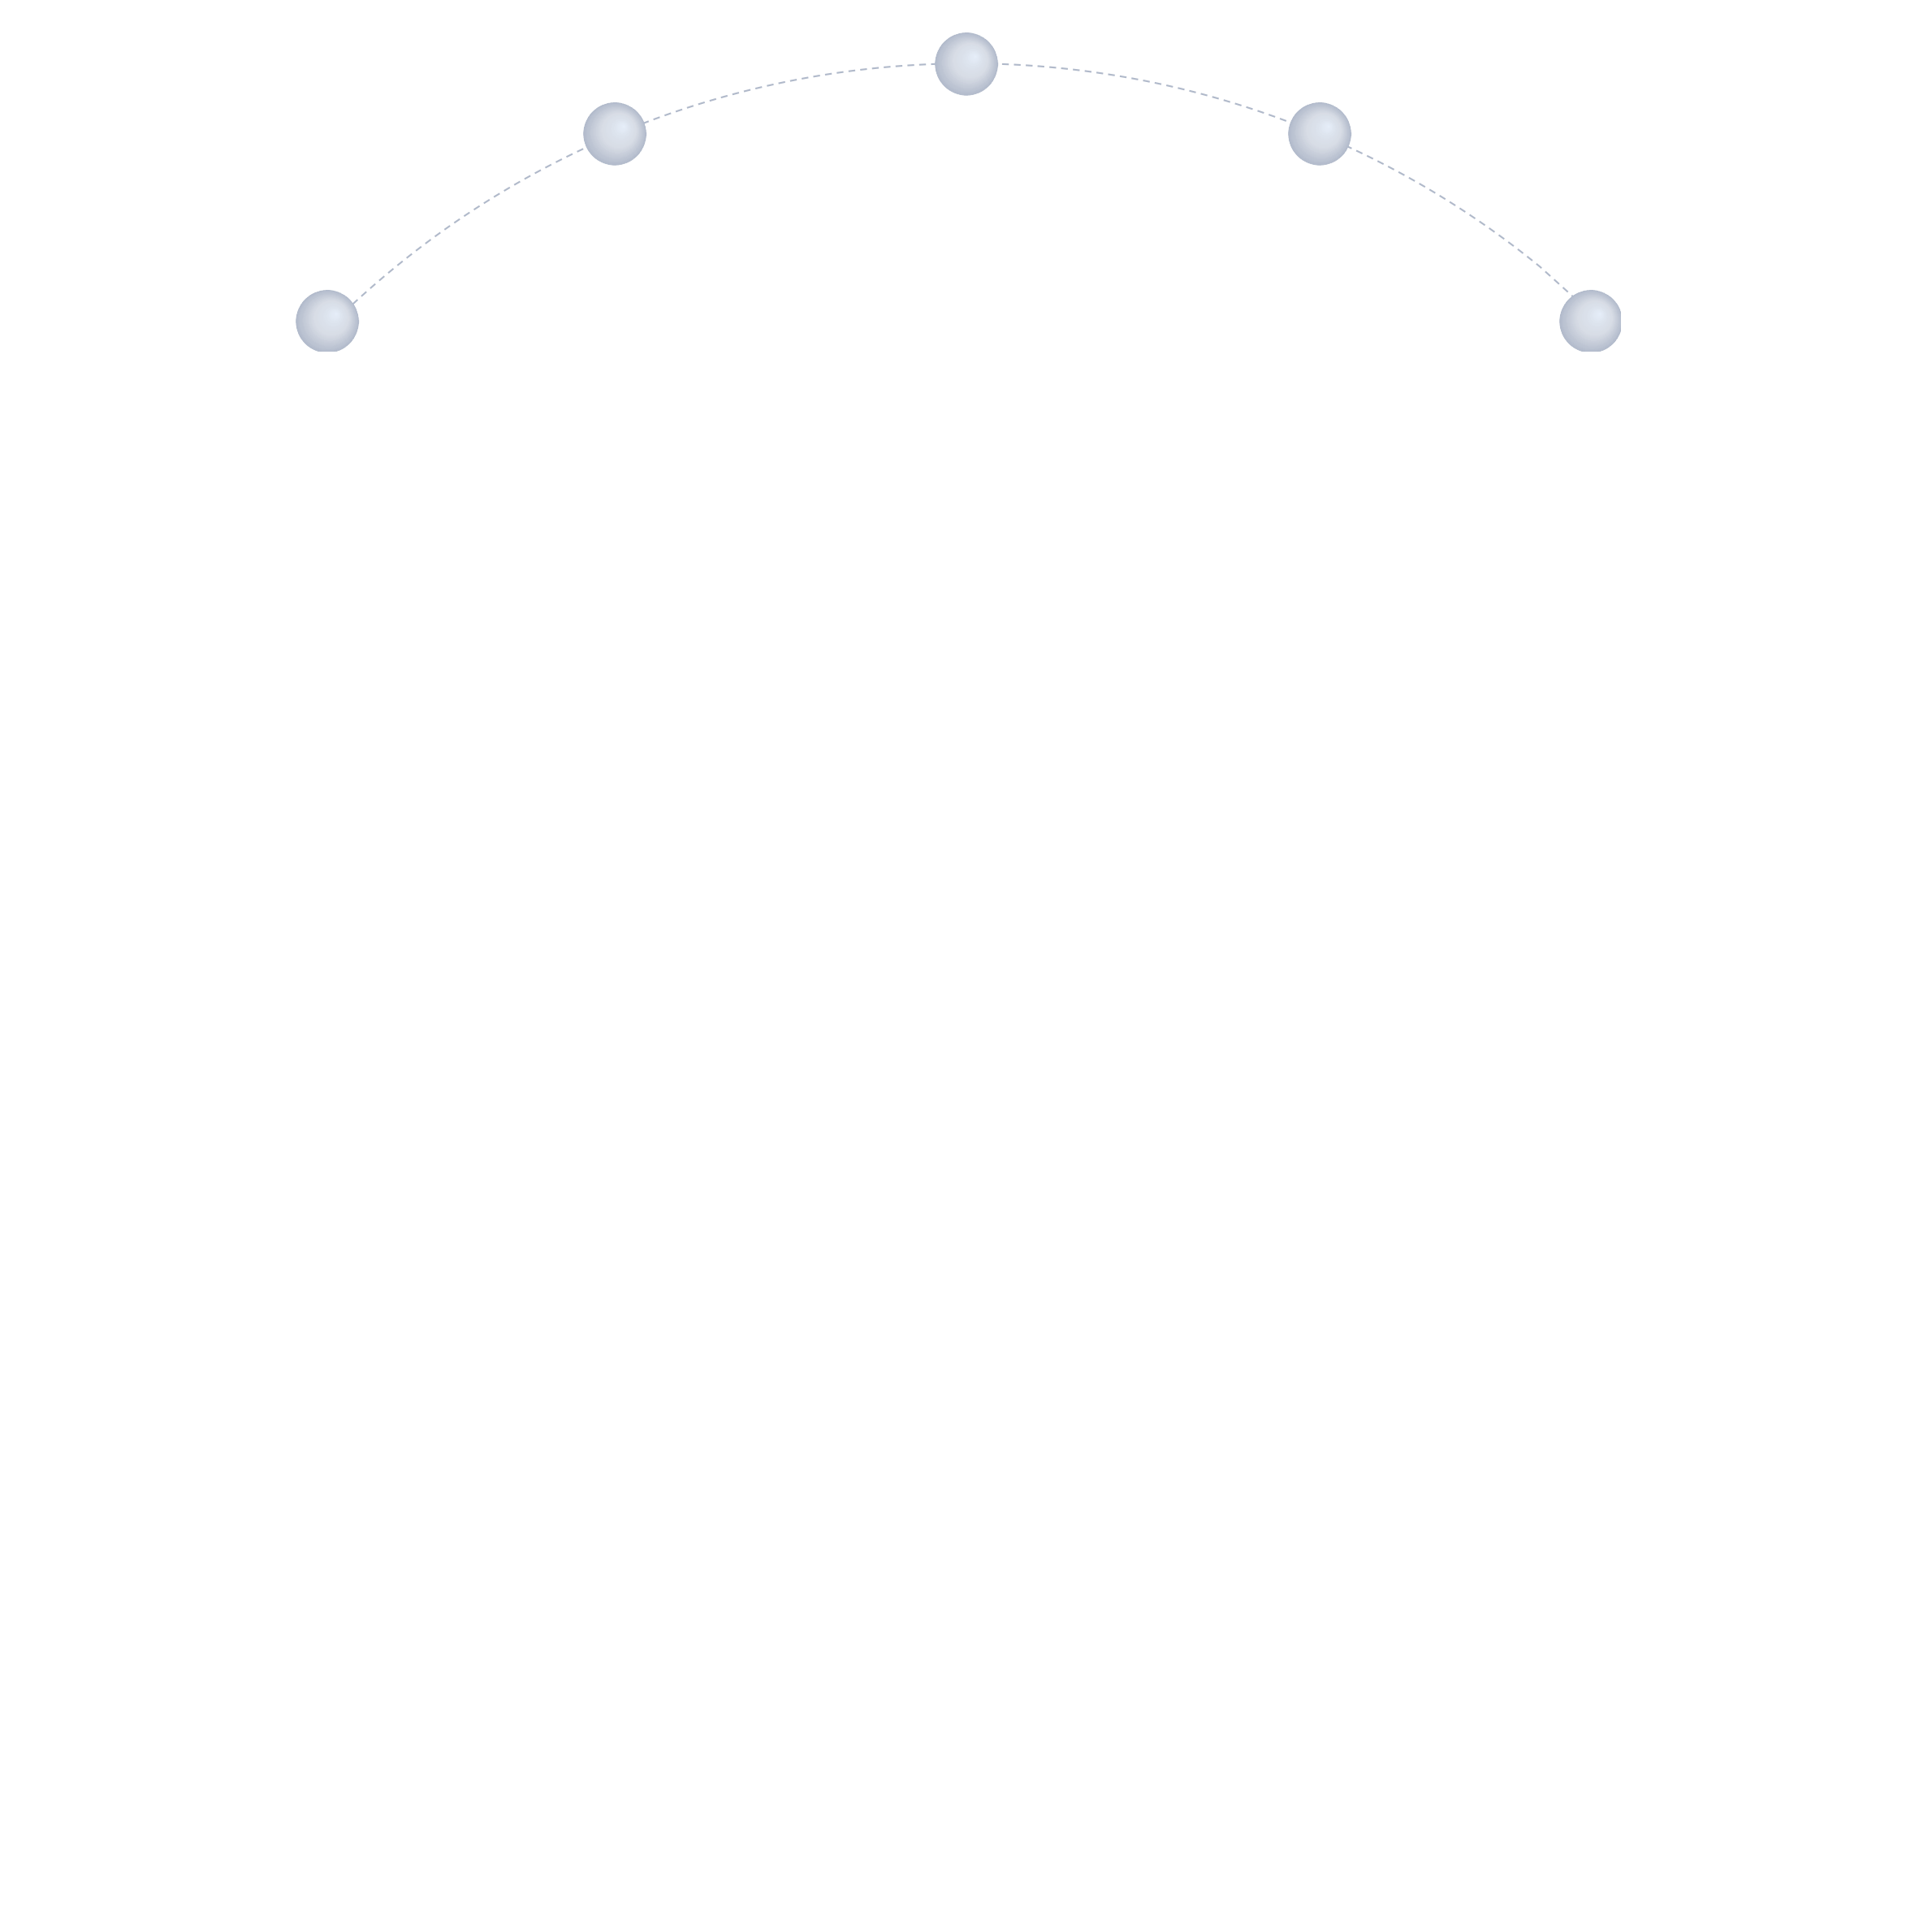
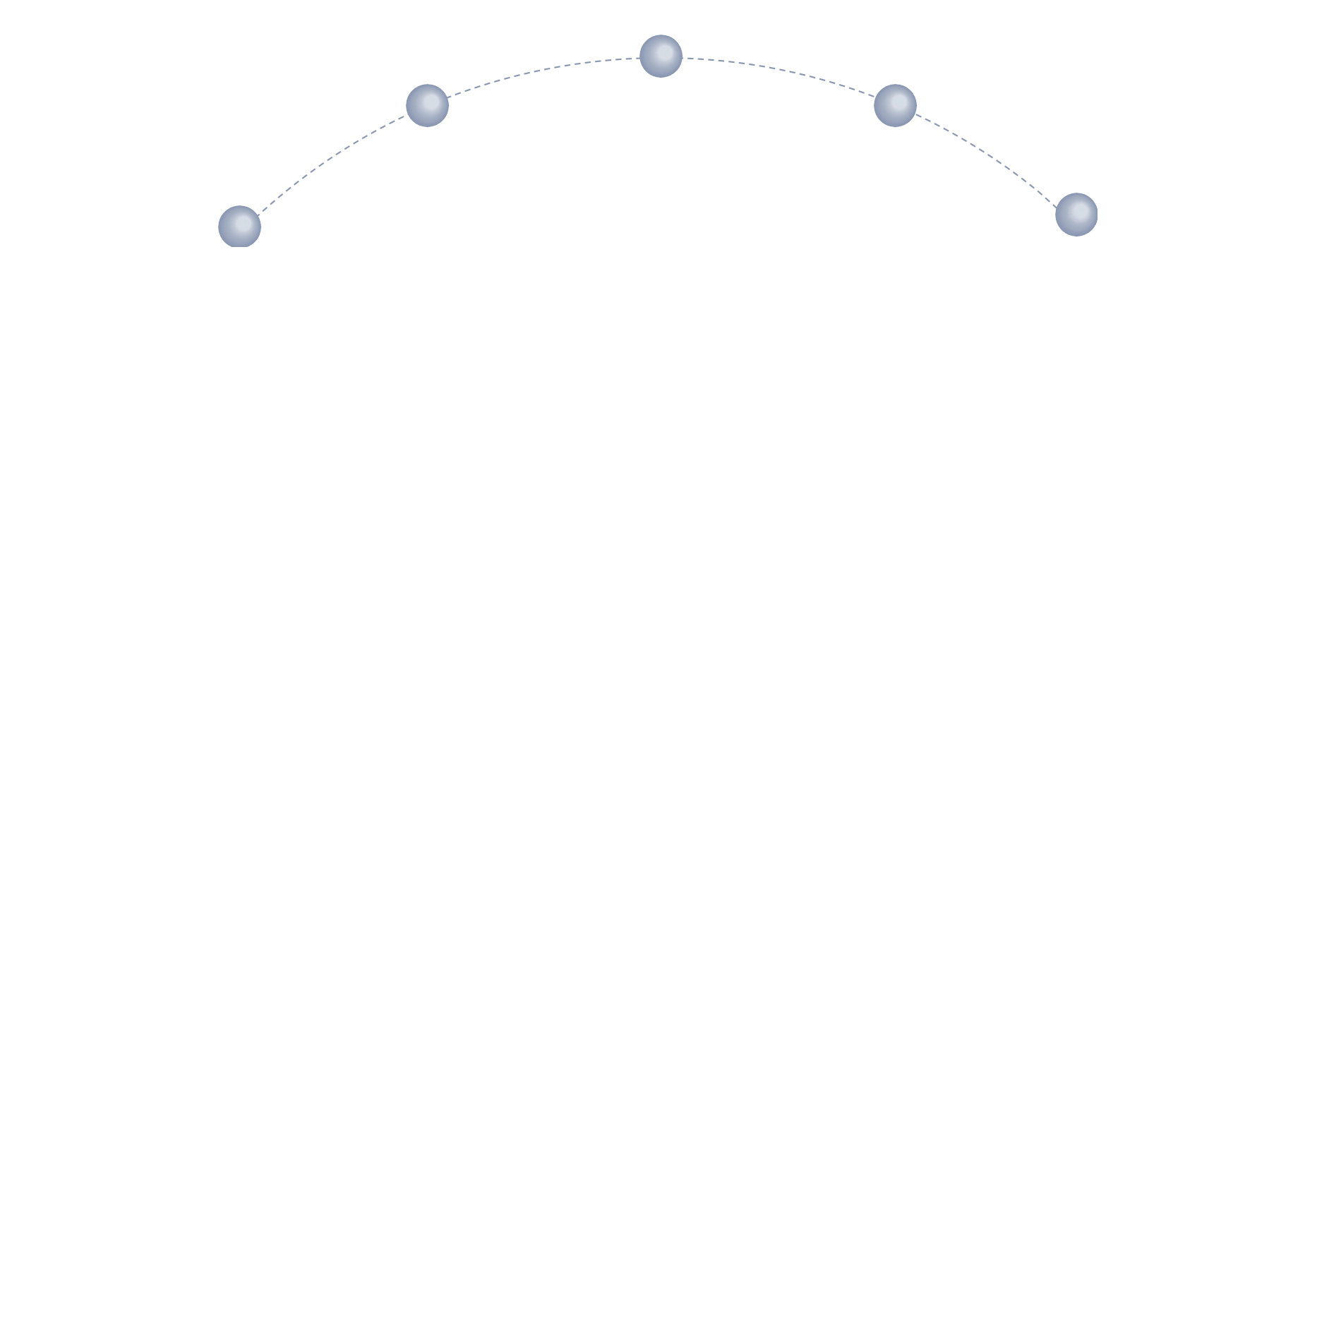
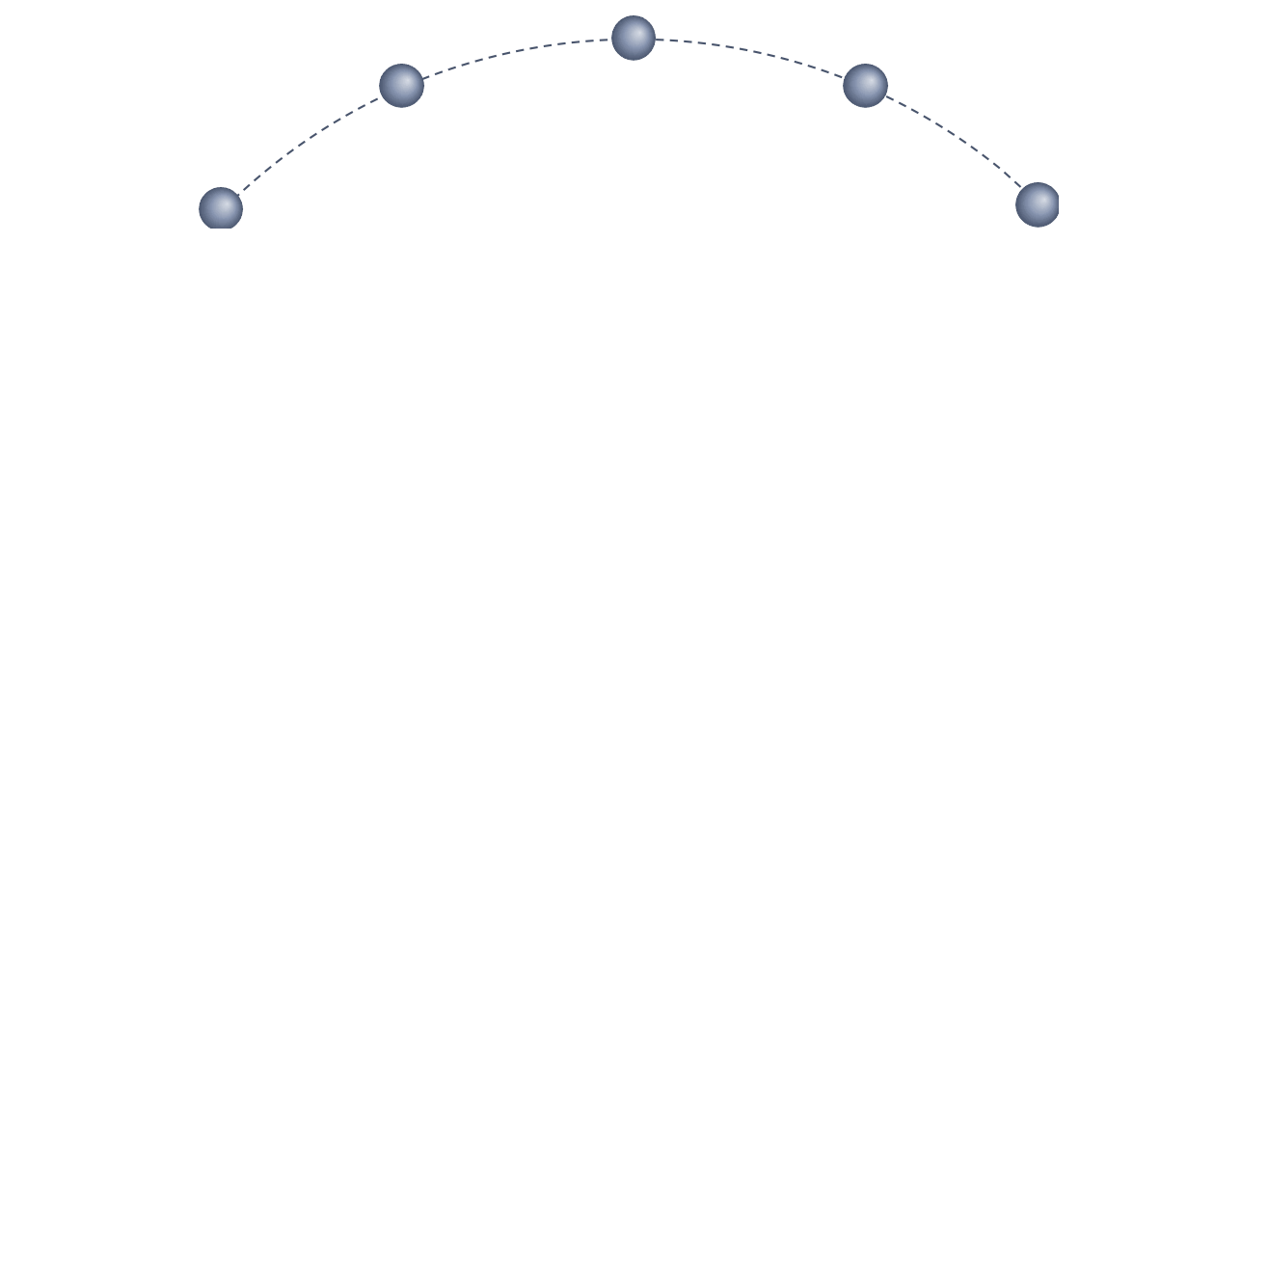
Future Improvements
- More efficient in data preparation
- Add feature engineering
- Add more ingredients to data collected from public repos
- Collect more details for requirements
- Consider Classification modeling
- Reduce complexity
Understanding to Preparation
- Expand problem coverage
- Add more channels of expertise for questionnaires
Requirements to Collection
Modelling to Evaluation
- Improves test data quantity
- Share results with peers with report
Problem to Approach
Deployment to Feedback

